Slide 1
CODING EXERCISES
24-08-2023
Krunal Kshirsagar

Slide 2
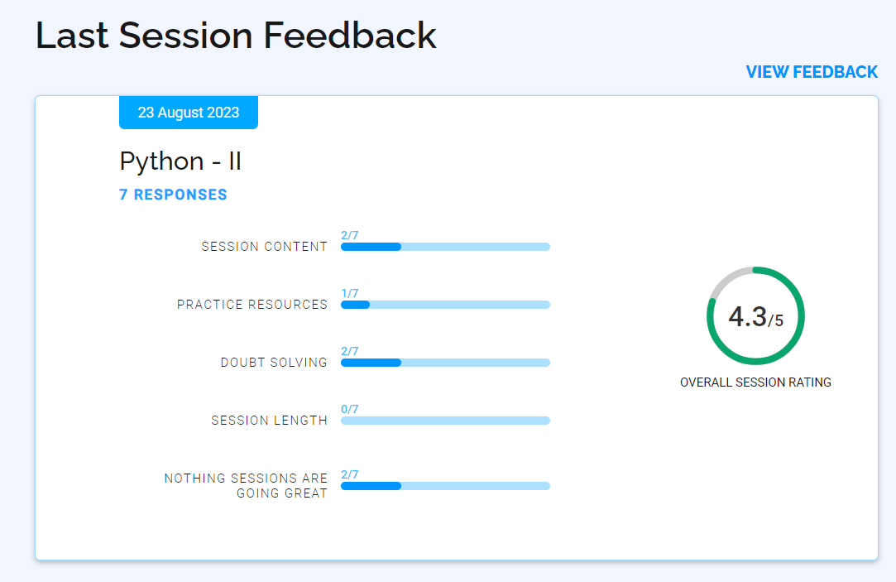

Slide 3
Theory Questions
Explain the purpose of exception handling in Python
What is the difference between the try, except, and finally blocks?
Can you have a finally block without a try block?
Explain the concept of string mutability/immutability in Python
How do you check if a substring exists within a string?

Slide 4
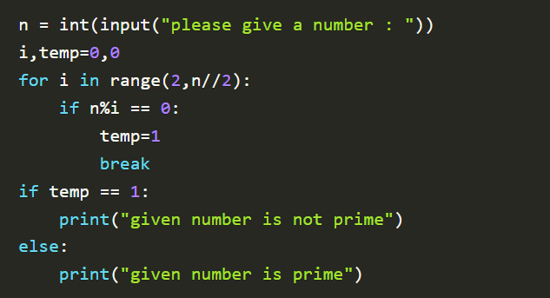
Write a program in Python to check given number is prime or not

Slide 5
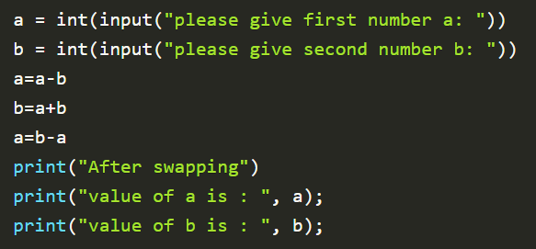
Write a program in Python to swap two numbers without using third variable?

Slide 6
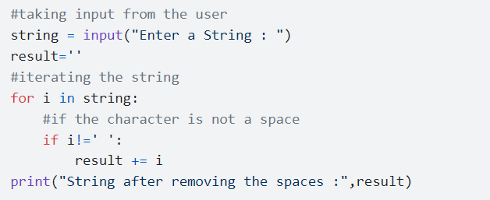
Python program to remove blank space from string

Slide 7
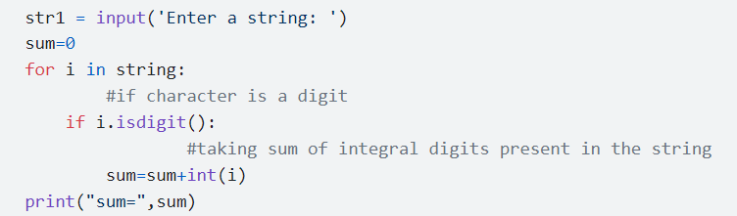
Python program to calculate sum of integers in string

Slide 8
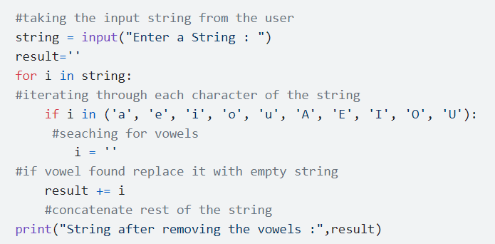
Python program to delete vowels in a given string

Slide 9
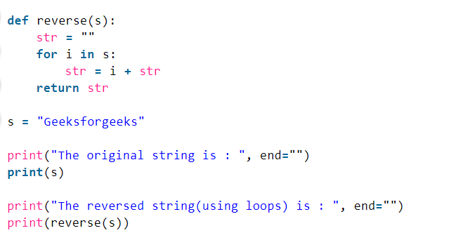
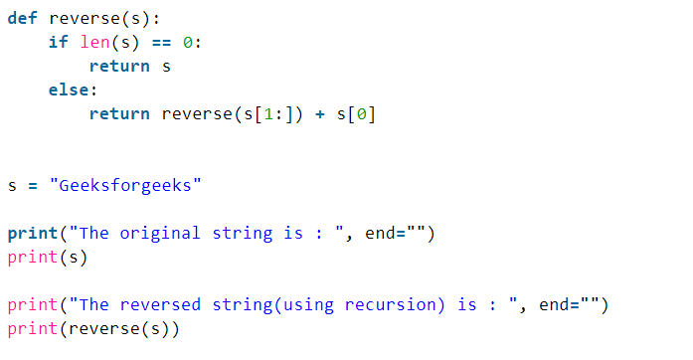
Python program to reverse the string

Slide 10
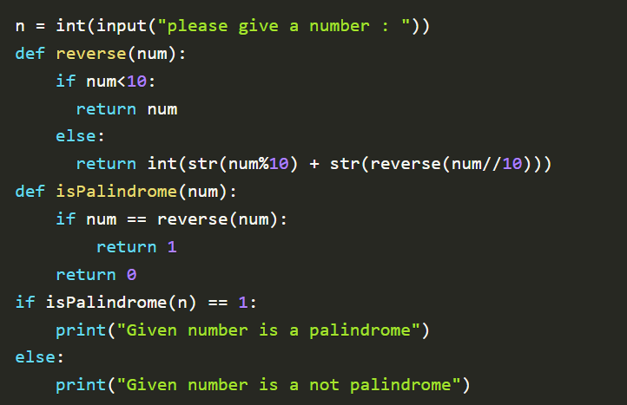
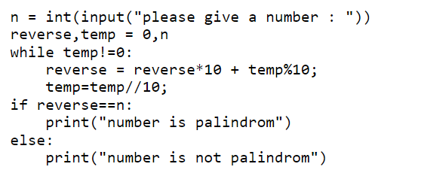
Write a program in Python to check whether a number is palindrome or not

Slide 11
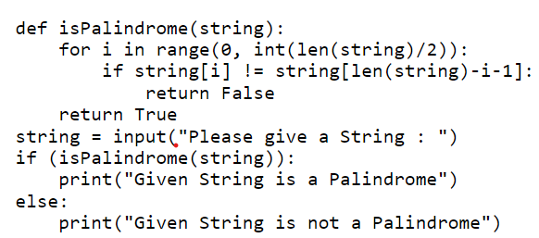
Python program to check if a String is palindrome or not using for loop

Slide 12
Interview Trick Questions
What is *args and **kwargs
What is the difference between deep copy and shallow copy?
What's the difference between ‘==‘ and ‘is’ and ‘=‘ for comparing in Python?
What's the output of print("hello" + 1)?
What happens when you have a function call with more arguments than parameters?
What's the output of print(3 == 3 == 3)
What happens when you divide by zero in Python?

Slide 13


Slide 14
Thanks!

